Slide 1









GOLD SPONSORS
SILVER SPONSORS
BRONZE SPONSOR
STRATEGIC PARTNER
Notes:
Test notatek

Slide 2
SSAS Multidimensional optimize for large data warehouse
Sławomir Drzymała

Slide 3

About me
Sławomir Drzymała
BI Consultant
Past: Betsson Group, JCommerce, Kamsoft
Member and speaker at Data Community
Leader and speaker and at MMDPUG
Cofounder of seequality.net
Blogger, trainer, organizer
Twitter: https://twitter.com/SDrzymala
Mail: slawomirdrzymala@outlook.com

Slide 4

Why this session / Introduction
I love cubes…
I had an experience…
I tough I know everything…
Large DWH / cube (3TB+)
Idea
Best practices
Real case scenarios
Rather for advanced users
There is a lot of stuff…

Slide 5
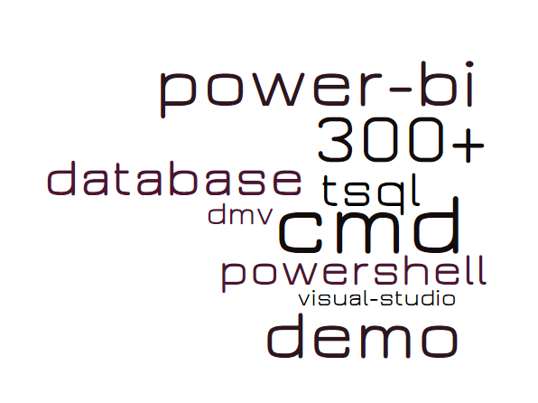
Agenda
Introduction
Analyzing the current state
Database design
Cube design
Deployment
Server
Processing
Monitoring
Documentation
Recap
Resources
Q&A
Notes:
Word cloud - https://worditout.com/word-cloud/create

Slide 6
Agenda
Introduction
Analyzing the current state
Database design
Cube design
Deployment
Server
Processing
Monitoring
Documentation
Recap
Resources
Q&A

Slide 7
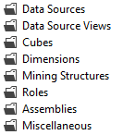

Introduction
SSAS Multidimensional since SQL Server 7
DWH
Cube structure – not a cube!
Process
MDX
Querying
Big DWH – big cube – big no files?
Good practices matters

Slide 8
Agenda
Introduction
Analyzing the current state
Database design
Cube design
Deployment
Server
Processing
Monitoring
Documentation
Recap
Resources
Q&A
Notes:
Word cloud - https://worditout.com/word-cloud/create

Slide 9
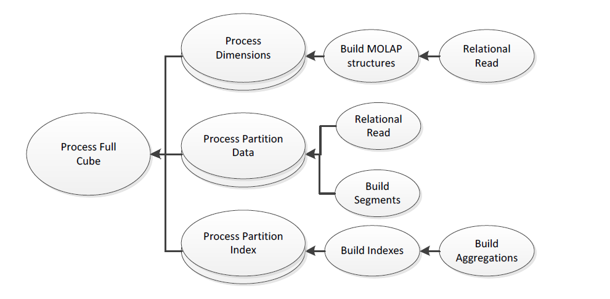



Analyzing the current state
User usage
Object activity
SSAS database size
Processing time
Collect data
Analyze data
Analysis Services Performance Guide, p.73
Notes:
If you can’t see ssas counters - https://andyhogg.wordpress.com/2014/10/03/repairing-dropped-ssas-performance-counters/

Slide 10
DEMO
Analyzing current state of SSAS database

Slide 11
Analyzing the current state
Combine results
Talk to business
Large cube
Many terabytes of files in hard disk
Many millions files
Many heavy users
Delete unnecessary objects!!!
Notes:
If you can’t see ssas counters - https://andyhogg.wordpress.com/2014/10/03/repairing-dropped-ssas-performance-counters/

Slide 12
Agenda
Introduction
Analyzing the current state
Database design
Cube design
Deployment
Server
Processing
Monitoring
Documentation
Recap
Resources
Q&A
Notes:
Word cloud - https://worditout.com/word-cloud/create

Slide 13
Database design
Star schema
Use numeric values for keys
Move everything you can to the ETL/DWH layer
Data types (money perform well, be carefull for overflow)
Limit number of attributes
Views (nolock/tablock)
Indexes
Null values in dimensions (not ok = null processing) and facts (ok)
Notes:
Re overflow
http://geekswithblogs.net/darrengosbell/archive/2006/11/27/99190.aspx
If you set up a 2 record fact table with 2 billion in each amount column and the measure's data type as int, you get the following result.
2000000000 Record 1
2000000000 Record 2
-294967296 Total <= Overflow!
Whereas when you change the data type of the measure to bigint, you get the following (correct) result
2000000000 Record 1
2000000000 Record 2
4000000000 Total
* Re data types: White Paper: Precision Considerations for Analysis Services Users
https://www.microsoft.com/en-us/download/details.aspx?id=4106

Slide 14
Database design
Optimize for large DWH
Limit number of distinct values
Pre-aggregate large fact tables
If needed… Aggregate the fact tables and use ROLAP for the rest
Fact
ROLAP
Fact
MOLAP
M2M_AggregatedFact_Fact
AggregatedFact
Regular
Fact
Many to Many
Regular
Regular
Dim
ROLAP
AggregatedFact
Dim
ROLAP
FactDetails

Slide 15
DEMO
Aggregate the fact tables and use another ROLAP dimension for details

Slide 16
Agenda
Introduction
Analyzing the current state
Database design
Cube design
Deployment
Server
Processing
Monitoring
Documentation
Recap
Resources
Q&A
Notes:
Word cloud - https://worditout.com/word-cloud/create

Slide 17
Cube design - dimensions
Use KeyColumns, NameColumn, ValueColumn
AttributeHierarchyEnabled
AttributeHierarchyVisible
AttributeHierarchyOrdered
IsAggregateable
Create hierarchies correctly
Rigid – but only if you are completely sure!!!
Build tree view
Limit unnatural hierarchies, leave natural
Avoid reference dimensions and many-to-many
Avoid Parent-Child – parent child = no aggregations
Notes:
In most cases, you want an attribute to have an explicit ordering. For example, you will want a City attribute to be sorted alphabetically. You should explicitly set the OrderBy or OrderByAttribute property of the attribute to explicitly control this ordering. Typically, this ordering is by attribute name or key, but it may also be another attribute. If you include an attribute only for the purpose of ordering another attribute, make sure you set AttributeHierarchyEnabled = false and AttributeHierarchyOptimizedState = NotOptimized to save on processing operations.
There are few cases where you don’t care about the ordering of an attribute, yet the surrogate key is one such case. For such hidden attribute that you used only for implementation purposes, you can set AttributeHierarchyOrdered = false to save time during processing of the dimension.
When a change is detected during process in a flexible relationship, all indexes for partitions referencing the affected dimension (including the indexes for attribute that are not affected) must be invalidated. This is an expensive operation and may cause Process Update operations to take a very long time. Indexes invalidated by changes in flexible relationships must be rebuilt after a Process Update operation with a Process Index on the affected partitions; this adds even more time to cube processing.
In a natural hierarchy, all attributes participating as levels in the hierarchy have direct or indirect attribute relationships from the bottom of the hierarchy to the top of the hierarchy.
In an unnatural hierarchy, the hierarchy consists of at least two consecutive levels that have no attribute relationships. Typically these hierarchies are used to create drill-down paths of commonly viewed attributes that do not follow any natural hierarchy. For example, users may want to view a hierarchy of Gender and Education.
ProcessingGroup – (ByAtribute, ByTable), default is to proces by atribute. In this case all atribute in processing separately with different SQL queries. Changing to proces by table can improve the performance
AtributeHierarchyEnabled - Determines whether an attribute hierarchy is generated by Analysis Services for the attribute. If set to false will be avaliable as a property
AtributeHierarchyOptimatedStatus - Determines the level of optimization applied to the attribute hierarchy. By default, an attribute hierarchy is FullyOptimized, which means that Analysis Services builds indexes for the attribute hierarchy to improve query performance. The other option, NotOptimized, means that no indexes are built for the attribute hierarchy. Using NotOptimized is useful if the attribute hierarchy is used for purposes other than querying, because no additional indexes are built for the attribute. Other uses for an attribute hierarchy can be helping to order another attribute.
Rigid attribute relationships boost performance
Whether an attribute relationship is Rigid or Flexible does not actually improve performance at all. Not query performance. A wrong choice here only affects processing of partition indexes. If an attribute relationship is static, setting it to Rigid means that you do not have to process partition indexes when you update the dimension. This is all the benefit you get from Rigid relationships. Going too far and marking changing relationships to Rigid may have a very negative impact as a change will prompt a complete process of the partition data and indexes, which will take much longer than updating just the indexes. Either way, there is no difference during query execution.
Parent-child hierarchies are hierarchies with a variable number of levels, as determined by a recursive relationship between a child attribute and a parent attribute. Parent-child hierarchies are typically used to represent a financial chart of accounts or an organizational chart. In parent-child hierarchies, aggregations are created only for the key attribute and the top attribute, i.e., the All attribute unless it is disabled. As such, refrain from using parent-child hierarchies that contain large numbers of members at intermediate levels of the hierarchy. Additionally, you should limit the number of parent-child hierarchies in your cube. If you are in a design scenario with a large parent-child hierarchy (greater than 250,000 members), you may want to consider altering the source schema to re-organize part or all of the hierarchy into a user hierarchy with a fixed number of levels. Once the data has been reorganized into the user hierarchy, you can use the Hide Member If property of each level to hide the redundant or missing members.” – SSAS Performance Guide

Slide 18
Cube design – partitions and aggregations
Partitions
Keep partitions relatively small, between 300mb and 3gb, more than 20 million of rows
The number of partitions shoudn’t be more than low thousands per cube 5 000 x 20 milions = 100 bilions, 50 000*50 millions = 500 bilions
Create a script for removing all partitions for TST/QAS/PRE-PROD
Manual slicers vs auto slice and IndexBuildThreshold!
Partition by date/month is quite okay
Aggregations
Can improve query performacne, but will reduce processing time
Use query-based optimization
Only for natural hierarchies
Check if they are working
Notes:
Use the date partitioning to selectively delete or merge old partitions. Use the second key to achieve parallelism during partition processing and to restrict certain users to a subset of the partitions.
Small cubes might not even need aggregations, because aggregations are not built for partitions with fewer records than the IndexBuildThreshold (which has a default value of 4096).
<IndexBuildThreshold> Index creation is controlled by the number of rows, specified in the msmdsrv.ini (default location of msmdsrv.ini file – ?:\Program Files\Microsoft SQL Server\MSAS10_50.SQL2008R2\OLAP\Config\msmdsrv.ini) file as <IndexBuildThreshold>, with a default of 4096. Partitions with fewer rows will not have indexes built. Which means if you have less than 4096 records in a Partition you will not see Index for same.

Slide 19
Cube design - MDX
First of all – simplify calculation script and Secondly, teach business users
Follow good practices
Scope
Non_empty behavior
Avoid arbitrary shaped sets - sets that cannot be solved with cross join
Performance monitor - MSOLAP:MDX/*
SQL Server Profiler
Total Execution Time = Formula Engine + Storage Engine
Sum(EventClass 10) = Formula Engine + Sum(EventClass 11)
Measure Group Cache – NOT OK, storage engine cache
Flat Cache – EVEN WORSE, cell by cell
Calculation Cache – OK, formula engine
Notes:
Measure Group Cache – is a storage engine cache, so data from here would need to be passed back to the formula engine to have any calculations executed. Hitting this probably means that something in your query or calculations prevents the formula engine from doing any caching. (ie. functions like Now() and Username() are non-deterministic and so results from them cannot be cached at the formula engine level).
Flat Cache – this is a formula engine cache, and is used to store individual cell values, but is only used when a query is executing in cell-by-cell mode. So if you see this it is an indication that your query is not executing in block mode (see description below). Flat Cache is a better type of cache than the Measure Group Cache.
Calculation Cache – this is a formula engine cache and is probably the best type of cache because it is used in block mode and stores the final results of any calculations.

Slide 20
DEMO
Sample MDX profiler troubleshooting

Slide 21
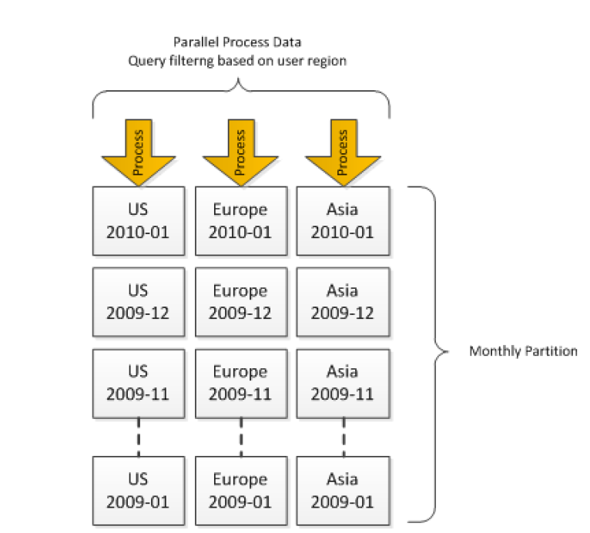
Cube design
Optimize for large DWH
Matrix partitioning
SSASPartitionManager.exe
Avoid having long texts
StringStoresCompatibilityLevel
ProcessingGroup by table
Security
Simplify the security
Use custom code to sync (?)
Better group users in active directory groups than have many users in SSAS roles
SSAS Perf Guilde 2008R2
Notes:
StringStreCompabilityLevel – 1050 – 4GB, 1100 – 8GB

Slide 22
Agenda
Introduction
Analyzing the current state
Database design
Cube design
Deployment
Server
Processing
Monitoring
Documentation
Recap
Resources
Q&A
Notes:
Word cloud - https://worditout.com/word-cloud/create

Slide 23


Deployment
Use Deployment Wizard
Retain roles and partitions if needed
Retain data source configuration
Execute on server
Remember that you can deploy MDX script only
Plan to minimize the impact for business users
Use source control
Notes:
Deploying MDX script only: https://www.purplefrogsystems.com/blog/2010/10/deploying-mdx-calculation-scripts-with-xmla/
You can use “answer” mode which will generate the config file for you "C:\Program Files (x86)\Microsoft SQL Server\140\Tools\Binn\ManagementStudio\Microsoft.AnalysisServices.Deployment.exe" "C:\code\adventure-works-multidimensional-model-project\Enterprise\AWDW2014Multidimensional-EE\bin\AWDW2014Multidimensional-EE.asdatabase" /a

Slide 24
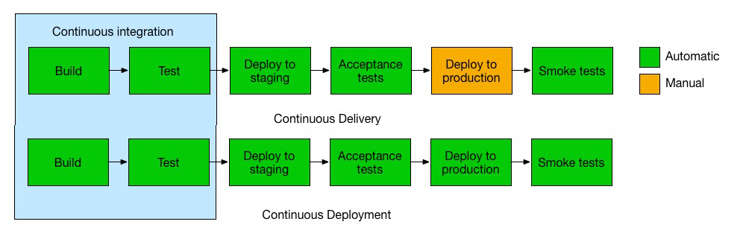
Deployment
Optimize for large DWH
Continuus integration (maybe deployment)
Prepare the templates for config files (bin folder)
configsettings –data source
deploymenttargets –target server
deploymentoptions –deployment properties, use answer mode of Microsoft.AnalysisServices.Deployment.exe
Use Microsoft.AnalysisServices.Deployment.exe from CMD or PowerShell
Keep only a few latests partitions in measuge groups in TEST/QAS/PREPROD
www.atlassian.com
Notes:
Deploying MDX script only: https://www.purplefrogsystems.com/blog/2010/10/deploying-mdx-calculation-scripts-with-xmla/
You can use “answer” mode which will generate the config file for you "C:\Program Files (x86)\Microsoft SQL Server\140\Tools\Binn\ManagementStudio\Microsoft.AnalysisServices.Deployment.exe" "C:\code\adventure-works-multidimensional-model-project\Enterprise\AWDW2014Multidimensional-EE\bin\AWDW2014Multidimensional-EE.asdatabase" /a
full image path : https://www.atlassian.com/continuous-delivery/ci-vs-ci-vs-cd
* Use pipe to Out-Null to force powershell wait when using any windows executeables

Slide 25
DEMO
Continuus integration for SSAS

Slide 26
Agenda
Introduction
Analyzing the current state
Database design
Cube design
Deployment
Server
Processing
Monitoring
Documentation
Recap
Resources
Q&A
Notes:
Word cloud - https://worditout.com/word-cloud/create

Slide 27
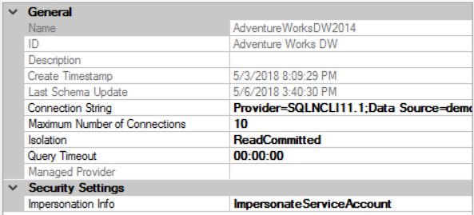
Server
Database setting (Data source)
Use the Microsoft OLE DB Provider for SQL Server
Adjust network packet size
Maximum number of connections
Adjust msmdsrv.ini (<instance dir>/OLAP/Config ) / basic properties, but be careful!
Disable flight recorder
Prealocation
LowMemoryLimit
TotalMemoryLimit
HardMemoryLimit
Notes:
Setting up memory options - http://byobi.com/2014/04/ssas-memory-configurations-for-common-architectures/
BufferMemoryLimit and BufferRecordLimit - OLAP\Process\BufferMemoryLimit determines the size of the fact data buffers used during partition data processing. You can use another configuration setting to control this behavior: BufferRecordLimit. This setting is expressed in received records from the data source instead of a Memory %/Kb size
Memory
LowMemoryLimit – This is the amount of memory that Analysis Services will hold on to, without trimming its working set. After memory goes above this value, Analysis Services begins to slowly deallocate memory that is not being used.
PreAllocate – This optional parameter (with a default of 0) enables you to preallocate memory at service startup.
TotalMemoryLimit –When Analysis Services exceeds this memory value, it starts deallocating memory aggressively from shrinkable memory and trimming its working set.
If Analysis Services goes above HardMemoryLimit, user sessions are selectively killed to force memory consumption down.
These two settings determine how much memory is allocated for the creation of aggregations and indexes in each partition. When Analysis Services starts partition processing, parallelism is throttled based on the AggregationMemoryMin/Max setting. The setting is per partition. For example, if you start five concurrent partition processing jobs with AggregationMemoryMin = 10, an estimated 50 percent (5 x 10%) of reserved memory is allocated for processing.
Client tools may not always clean up sessions opened on the server. The memory consumed by active sessions is non-shrinkable, and hence is not returned the Analysis Services or operating system process for other purposes. After a session has been idle for some time, Analysis Services considers the session expired and move the memory used to the shrinkable memory space. But the session still consumes memory until it is cleaned up.
ThreadPool\Process\MaxThreads determines the maximum number of available threads to Analysis Services during processing and for accessing the I/O system during queries. On large, multiple-CPU machines, the default value in SQL Server 2008 Analysis Services and SQL Server 2008 R2 Analysis Services of 64 or 10 multiplied by the number of CPU cores (whichever is higher) may be too low to take advantage of all CPU cores. In SQL Server 2005 Analysis Services the settings for process thread pool were set to the static value of 64. If you are running an installation of SQL Server 2005 Analysis Services, or if you upgraded from SQL Server 2005 Analysis Services to SQL Server 2008 Analysis Services or SQL Server 2008 R2 Analysis Services, it might be a good idea to increase the thread pool.
ThreadPool\Query\MaxThreads determines the maximum number of threads available to the Analysis Services formula engine for answering queries. In SQL Server 2008 Analysis Services and SQL Server 2008 R2 Analysis Services, the default is 2 multiplied by the number of logical CPU or 10, whichever is higher. In SQL Server 2005 Analysis Services, the default value was fixed at 10. Again, if you are running on SQL Server 2005 Analysis Services or an upgraded SQL Server 2005 Analysis Services, you may want to use the new settings.
Shared memory - If Analysis Services is on the same physical machine as the data source, and the data source is SQL Server, you should make sure you are exchanging data over the shared memory protocol. Shared memory is much faster than TCP/IP, as it avoids the overhead of the translation layers in the network stack. After you start processing, you can verify your connection is using shared memory by executing the following SELECT statement.
SELECT session_id, net_transport, net_packet_size
FROM sys.dm_exec_connections

Slide 28
Server
Optimize for large DWH
Try adjust msmdsrv.ini (<instance dir>/OLAP/Config ) / advanced properties
CoordinatorExecutionMode, CoordinatorQueryMaxThreads
AggregationMemoryMin, AggregationMemoryMax
BufferMemoryLimit and BufferRecordLimit
MinIdleSessionTimeout, MaxIdleSessionTimeout
IdleOrphanSessionTimeout, IdleConnectionTimeout, Min/Max IdleSessionTimeOut
ForceCommitTimeout, CommitTimeout
ThreadPool\Process\MaxThreads and ThreadPool\Query\MaxThreads
"Disable Prefetch Facts=True; Cache Ratio=1” in client tools
Shared memory, add lpc to connection string for data source to enforce
Using multiple NICs for processing
Notes:
CoordinatorExecutionMode, CoordinatorQueryMaxThreads - Setting concurrency of queries in thread pool during query execution
AggregationMemoryMin, AggregationMemoryMax - Increasing parallelism of partition processing,
BufferMemoryLimit and BufferRecordLimit - Increasing compression during processing, but consuming more memory
MinIdleSessionTimeout, MaxIdleSessionTimeout - Cleaning up idle sessions faster on systems that have many connect/disconnects
IdleOrphanSessionTimeout, IdleConnectionTimeout, Min/Max IdleSessionTimeOut
ForceCommitTimeout, CommitTimeout - Killing queries that are blocking a processing operation or killing the processing operation
ThreadPool\Process\MaxThreads and ThreadPool\Query\MaxThreads - Increasing thread pools for high concurrency systems
Setting up memory options - http://byobi.com/2014/04/ssas-memory-configurations-for-common-architectures/
BufferMemoryLimit and BufferRecordLimit - OLAP\Process\BufferMemoryLimit determines the size of the fact data buffers used during partition data processing. You can use another configuration setting to control this behavior: BufferRecordLimit. This setting is expressed in received records from the data source instead of a Memory %/Kb size
Memory
LowMemoryLimit – This is the amount of memory that Analysis Services will hold on to, without trimming its working set. After memory goes above this value, Analysis Services begins to slowly deallocate memory that is not being used.
PreAllocate – This optional parameter (with a default of 0) enables you to preallocate memory at service startup.
TotalMemoryLimit –When Analysis Services exceeds this memory value, it starts deallocating memory aggressively from shrinkable memory and trimming its working set.
If Analysis Services goes above HardMemoryLimit, user sessions are selectively killed to force memory consumption down.
These two settings determine how much memory is allocated for the creation of aggregations and indexes in each partition. When Analysis Services starts partition processing, parallelism is throttled based on the AggregationMemoryMin/Max setting. The setting is per partition. For example, if you start five concurrent partition processing jobs with AggregationMemoryMin = 10, an estimated 50 percent (5 x 10%) of reserved memory is allocated for processing.
Client tools may not always clean up sessions opened on the server. The memory consumed by active sessions is non-shrinkable, and hence is not returned the Analysis Services or operating system process for other purposes. After a session has been idle for some time, Analysis Services considers the session expired and move the memory used to the shrinkable memory space. But the session still consumes memory until it is cleaned up.
ThreadPool\Process\MaxThreads determines the maximum number of available threads to Analysis Services during processing and for accessing the I/O system during queries. On large, multiple-CPU machines, the default value in SQL Server 2008 Analysis Services and SQL Server 2008 R2 Analysis Services of 64 or 10 multiplied by the number of CPU cores (whichever is higher) may be too low to take advantage of all CPU cores. In SQL Server 2005 Analysis Services the settings for process thread pool were set to the static value of 64. If you are running an installation of SQL Server 2005 Analysis Services, or if you upgraded from SQL Server 2005 Analysis Services to SQL Server 2008 Analysis Services or SQL Server 2008 R2 Analysis Services, it might be a good idea to increase the thread pool.
ThreadPool\Query\MaxThreads determines the maximum number of threads available to the Analysis Services formula engine for answering queries. In SQL Server 2008 Analysis Services and SQL Server 2008 R2 Analysis Services, the default is 2 multiplied by the number of logical CPU or 10, whichever is higher. In SQL Server 2005 Analysis Services, the default value was fixed at 10. Again, if you are running on SQL Server 2005 Analysis Services or an upgraded SQL Server 2005 Analysis Services, you may want to use the new settings.
Shared memory - If Analysis Services is on the same physical machine as the data source, and the data source is SQL Server, you should make sure you are exchanging data over the shared memory protocol. Shared memory is much faster than TCP/IP, as it avoids the overhead of the translation layers in the network stack. After you start processing, you can verify your connection is using shared memory by executing the following SELECT statement.
SELECT session_id, net_transport, net_packet_size
FROM sys.dm_exec_connections
If you are hitting a network bottleneck when you process your cube, you can add additional NICs to increase throughput. There are two basic configurations for using multiple NICs on a server. The first and default option is to use the NICs separately. The second option is to use NIC teaming. Multiple NICs can be used individually to concurrently run many multipartition processing commands. Each partition in Analysis Services can refer to a different data source, and it is this feature you make use of. To use multiple NICs, follow these steps: Set up NICs with different IP numbers. Add new data sources. Change your partition setup to reference the new data sources. First, set up multiple NICs in the source and the target, each with its own IP number. Match each NIC on the cube server with a corresponding NIC on the relational database. Set up the subnet mask so only the desired NIC on the source can be reached from its partner on the cube server. If you are limited in bandwidth on the switches or want to create a very simple setup, you can use this technique with a crossover cable, which we have done successfully Second, add a data source for each NIC on the data source, and set up each data source to point to its own source NIC. Third, configure partitions in the cube so that they are balanced across all data sources. For example, if you have 16 partitions and 4 data sources per NIC – point 4 partitions to each data source.

Slide 29
Agenda
Introduction
Analyzing the current state
Database design
Cube design
Deployment
Server
Processing
Monitoring
Documentation
Recap
Resources
Q&A
Notes:
Word cloud - https://worditout.com/word-cloud/create

Slide 30
Processing
First of all learn how does the SSAS is working SSAS: Which change makes the cube/dimension unprocessed? by Mickael
Once a week - process full everything
On daily basis
Process update dimensions
Process data new partitions
Process index cube
After major deployment
Process full dimensions
Process structure
Process measure groups (all)
Process update dimensions (ProcessAffectedObjects )
Process data new partitions
Process index new partitions
Process structure | Without process structure
At least on partition | At least one partition For every measure group
Notes:
Note: check the following blog post series: http://henkvandervalk.com/how-to-process-a-ssas-molap-cube-as-fast-as-possible-part-1 https://blogs.msdn.microsoft.com/karang/2011/01/25/different-kinds-of-ssas-processing-in-simple-words/
http://www.jamesserra.com/archive/2012/05/being-careful-in-ssas-to-not-make-a-cubedimension-unprocessed/
ProcessFull - Simple to digest, applies all objects which means it discards the storage contents of the object and rebuilds them. It applies to descendants objects as well.
ProcessDefault - It does the bare minimum task to bring the objects to a fully processed state which means it build only storage contents which are not currently built. For eg, if you have created new project and just deployed to AS server then ProcessDefault on Database will do full processing or take another case where Partition has fact and aggregation data, then ProcessDefault will only build bitmap indexes.
But in case if you change the binding of an object(eg, change the structure of an object, like added attribute or removed attribute), in that case ProcessDefault on the object will discard all the storage contents and rebuild them.
ProcesData - Applies to dimension, cube, measure group and partition. It discards the storage contents and rebuilds only data.
Dimension it builds Hierarchy and Attributes
Partitions it builds the fact data.
ProcessIndexes - Applies to dimension, cube, measure group, and partition. It requires that the object must already have its "data" built; otherwise, it raises an error. ProcessIndexes preserves the data and rebuilds the "indexes". For dimensions, it builds the bitmap indexes. For partitions, it builds the aggregation data and bitmap indexes. ProcessIndexes is recursively applied to all descendants of the object as well.
ProcessUpdate - Now here is the most confusing part of all. It applies only to Dimension. It is the equivalent of incremental dimension processing in Analysis Services 2000. It sends SQL queries to read the entire dimension table and applies the changes—member updates, additions, deletions.
Since ProcessUpdate reads the entire dimension table, it begs the question, "How is it different from ProcessFull?" The difference is that ProcessUpdate does not discard the dimension storage contents. It applies the changes in a "smart" manner that preserves the fact data in dependent partitions. ProcessFull, on the other hand, does an implicit ProcessClear on all dependent partitions. ProcessUpdate is inherently slower than ProcessFull since it is doing additional work to apply the changes.
Depending on the nature of the changes in the dimension table, ProcessUpdate can affect dependent partitions. If only new members were added, then the partitions are not affected. But if members were deleted or if member relationships changed (e.g., a Customer moved from Redmond to Seattle), then some of the aggregation data and bitmap indexes on the partitions are dropped. The cube is still available for queries, albeit with lower performance.(with ProcessUpdate Flexible aggregations and indexes on related partitions will be dropped)
Which means after ProcessUpdate you need to Process Indexes on the Partitions. The simple approach of dealing with such problem is to do default processing on associated Cubes, default processing will create dropped Aggregations and Bitmap indexes for affected partitions.
If you want to check Aggregations which are dropped after Process Update then follow these task (Applies only to SQL 2008)
1) Take the output (Save it for later comparison) firing this DMV
SELECT *
FROM SYSTEMRESTRICTSCHEMA($SYSTEM.DISCOVER_PARTITION_STAT
, CUBE_NAME='Adventure Works'
, DATABASE_NAME = 'AdventureWorksDW2008'
, MEASURE_GROUP_NAME = 'Sales Orders'
, PARTITION_NAME='Total_Orders_2004'
)
2) Process Update Dimension which impacts this Cube
3) Again fire the same command as specified in step 1 you will find few aggregations will be dropped.
For checking Impacted Indexes follow these steps (Applies only to SQL 2008)
1) Take the output (Save it for later comparison) by firing this DMV
SELECT * FROM SYSTEMRESTRICTSCHEMA(
$SYSTEM.DISCOVER_PARTITION_DIMENSION_STAT
, CUBE_NAME = ‘Adventure Works’c
, DATABASE_NAME = ‘Adventure Works DW’
, MEASURE_GROUP_NAME = ‘Sales Orders’
, PARTITION_NAME=’Total_Orders_2004'
)
2) Process Update Dimension which impacts this cube
3) Again fire the same command as specified in step 1 and look for Attribute_Indexed Col, do comparisons with output of Step 1 you will find differences
ProcessAdd - Applies to Dimensions and Partitions, it didn't existing in SSAS 2000. It essentially optimizes ProcessUpdate in scenerios where you are adding only new records to Dimension and facts.
Before using this Processing Type you need to guarantee that only new rows are added. ProcessAdd never deletes or updates existing members. It only adds new members. The users can restrict the dimension table so that ProcessAdd reads only the new rows.
Good News unlike ProcessUpdate - ProcessAdd doesn't drop aggregations and indexes.
This option is not available in GUI you need to fire it using only XMLA (ProcessADD)
ProcessClear - Discards the storage of the object, it applies to all objects and descendants objects as well.
http://datanit.com/ssas/processing/partition-processing-multidimensional/
When we talk about processing a partition, there are two parts to it: 1) Processing Data which rebuilds fact/partition data store by Reading data from relational database and Writing compressed data in fact/partition data store. 2) Processing Indexes which creates bitmap indexes and aggregation defined in the model for that partition.
ProcessFull: We can execute a single command ProcessFull to perform above two operations together or execute separate commands ProcessData and ProcessIndexes for each of these operations, this way we can identify how much time each operation is taking. ProcessFull or ProcessData/ProcessIndexes both clears existing data in the partition and then reloads it with new data.
ProcessAdd: In case we want to incrementally update a partition with just new data while keeping old data as it is we can use ProcessAdd. SSAS actually creates new partition containing only new rows and merges this new partition with old partition. For using ProcessAdd we need to have SQL query created in a such a way that it returns new rows only. For handling Inserts, Updates and Deletes using ProcessAdd we need to have different type of of SQL query for operation as mentioned below
ProcessFull – caters for them all
Handling Inserts with ProcessAdd
SQL query that adds new rows
Handling Updates with ProcessAdd
SQL query that negates old rows and adds new rows
Handling Deletes with ProcessAdd
SQL query that negates old rows
You might choose to do the full process each time or you might do the full process followed by subsequent incremental processes. No matter what approach you use, SSAS uses job based architecture (creates a controller jobs and many other jobs depending on number of attributes, hierarchies, partitions etc.) for processing dimensions and facts.
NOTE: During processing, key/value pairs for all dimensions loaded into memory Large dimensions can cause SSAS to process in multiple passes.
Over the last few days I’ve been involved in an interesting thread on the SSAS forum regarding what happens when you do a Process Update on a dimension. It’s a topic that is not widely understood, and indeed I’ve not known all the details until today, but it’s nonetheless very important: one of the commonest performance-related problems I see in my consultancy work is partitions that have aggregations designed for them, but where those aggregations aren’t in a processed state because a Process Update has been run on one or more dimensions. Anyway, just now Akshai Mirchandani from the dev team posted a really good overview of what actually happens when you run a Process Update on that thread, so I thought I’d copy here to ensure it gets a wider audience:
Here is a quick summary of what happens when you do ProcessUpdate:
1. After the dimension has been updated, the server analyzes the changes that occurred to the dimension. In 2005, this analysis was pretty simple and would often incorrectly detect that major changes had occurred that required clearing of indexes and aggregations. In 2008, this code was improved such that it more often would realize that nothing significant has occurred. It’s a fairly small (but useful) optimization — I guess nobody thought it was worth documenting!
2. Based on this analysis, the server will decide whether or not indexes and aggregations need to be cleared. If no (e.g. because records were only added and not deleted/updated), then the partitions won’t be affected.
3. If indexes/aggregations need to be cleared, then the server will check if ProcessAffectedObjects was enabled — if yes, then instead of clearing the indexes/aggregations it will rebuild the indexes/aggregations.
4. The act of clearing the indexes/aggregations also shows up as "partition processing operations" in Profiler — that’s one of the things that has been confusing some of you.
5. When aggregations are cleared, only the flexible aggregations need to be cleared because we’re guaranteed by the rigid relationships that the members cannot have moved and therefore the rollups cannot have changed. However, indexes can still have changed and therefore you may still see the partition processing jobs kick off to clear the indexes.
6. ProcessIndexes and ProcessClearIndexes take care of building both bitmap indexes (aka map) and aggregations — the context is that both aggregations and bitmap indexes are generically considered "indexes".
Really the main takeaway here is that if you ProcessUpdate a dimension, you should strongly consider either doing ProcessAffectedObjects or an explicit ProcessIndexes on the affected partitions so that bitmap indexes and flexible aggregations get rebuilt. The advantage of explicitly doing ProcessIndexes is that you can bring your cube online earlier and have the indexes/aggregations get processed more lazily in the background — a number of customers prefer to do that because their processing windows are too small to wait for the indexes to get processed.
Also related to this topic, I thought I’d also highlight a great post by Darren Gosbell where he shows how to find out if your aggregations are processed or not:
http://geekswithblogs.net/darrengosbell/archive/2008/12/02/ssas-are-my-aggregations-processed.aspx
If you use ProcessUpdate the flexible aggregations are dropped and they are not recreated automatically.
Below you can find a quote from the Analysis Services 2005 performance guide which lists the possibilities you can use to recreate the indexes.
Flexible aggregations
An aggregation is flexible when one or more of the attributes participating in the aggregation have flexible direct or indirect relationships to the key attribute.
If you perform a ProcessUpdate on a dimension participating in flexible aggregations, whenever deletions or updates are detected for a given attribute, the aggregations for that attribute as well as any related attributes in the attribute chain are automatically dropped. The aggregations are not automatically recreated unless you perform one of the following tasks:
· Perform a ProcessFull on the cube, measure group, or partition. This is the standard ProcessFull operation that drops and re-creates the fact data and all aggregations in the partition.
· Perform a ProcessIndexes on the cube, measure group, or partition. By performing ProcessIndexes, you will only build whatever aggregations or indexes that need to be re-built.
· Configure Lazy Processing for the cube, measure group, or partition. If you configure Lazy Processing, the dropped aggregations are recalculated as a background task. While the flexible aggregations are being recalculated, users can continue to query the cube (without the benefit of the flexible aggregations). While the flexible aggregations are being recalculated, queries that would benefit from the flexible aggregations run slower because Analysis Services resolves these queries by scanning the fact data and then summarizing the data at query time. As the flexible aggregations are recalculated, they become available incrementally on a partition-by-partition basis. For a given cube, Lazy Processing is not enabled by default. You can configure it for a cube, measure group, or partition by changing the ProcessingMode property from Regular to LazyAggregations. To manage Lazy Processing, there are a series of server properties such as the LazyProcessing \ MaxObjectsInParallel setting, which controls the number of objects that can be lazy processed at a given time. By default it is set to 2. By increasing this number, you increase the number of objects processed in parallel; however, this also impacts query performance and should therefore be handled with care.
· Process affected objects. When you perform a ProcessUpdate on a dimension, you can choose whether or not to Process Affected Objects. If you select this option, you can trigger the update of dependent partitions within the same operation.
More: [PL] Procesowanie i partycjonowanie SSAS od podszewki – Adrian Chodkowski

Slide 31
DEMO
Process dimensions – Process structure – Process partitions

Slide 32
Processing
Optimize for large DWH
Warming cache Cache-warming_strategies_for_AS_2008 by C. Webb
Close idle and active connections during processing if needed
Avability and/or sacability
Scaling / Server consolidation / Load balancing
Attach-Detach / Backup-Restore / Robocopy / Synchronization
SQL Server
DWH
SSAS Processing Server
SQL Server
DWH
Sync
SSAS Querying Server
Users
Notes:
Improving robocopy - https://blog.calvett.co.uk/2012/07/07/ssas-multithreaded-sync-with-windows-2008-r2/
https://docs.microsoft.com/en-us/sql/analysis-services/instances/high-availability-and-scalability-in-analysis-services?view=sql-analysis-services-2017
http://www.jamesserra.com/archive/2017/05/ssas-high-availability/

Slide 33
Processing
Optimize for large DWH
Warming cache Cache-warming_strategies_for_AS_2008 by C. Webb
Close idle and active connections during processing if needed
Avability and/or sacability
Scaling / Server consolidation / Load balancing
Attach-Detach / Backup-Restore / Robocopy / Synchronization
SQL Server
DWH
SSAS #1
SQL Server
DWH
DNS Name
Users
Sync
SSAS #2
Notes:
Improving robocopy - https://blog.calvett.co.uk/2012/07/07/ssas-multithreaded-sync-with-windows-2008-r2/
https://docs.microsoft.com/en-us/sql/analysis-services/instances/high-availability-and-scalability-in-analysis-services?view=sql-analysis-services-2017
http://www.jamesserra.com/archive/2017/05/ssas-high-availability/

Slide 34
DEMO
Synchronization / Robocopy

Slide 35
Agenda
Introduction
Analyzing the current state
Database design
Cube design
Deployment
Server
Processing
Monitoring
Documentation
Recap
Resources
Q&A
Notes:
Word cloud - https://worditout.com/word-cloud/create

Slide 36
Monitoring
Files
Server logs, Query Log, Error log
Flight recorder
SQL Server Profiler
Extended Events
Performance Monitor
DMV’s
Others (BI Sentry for AS, SQLSrvAnalysisSrvcs, SSAS SP, asactivityviewer2012)
Custom (above + C# / Powershell / whatever ) ie my ssas_toolbox
More details
[PL] Metody monitorowania i optymalizacji SQL Server Analysis Services (SSAS)
Notes:
Link to my toolbox https://github.com/seequality/seequality_ssas/tree/master/ssas_tollbox

Slide 37
Agenda
Introduction
Analyzing the current state
Database design
Cube design
Deployment
Server
Processing
Monitoring
Documentation
Recap
Resources
Q&A
Notes:
Word cloud - https://worditout.com/word-cloud/create

Slide 38

Documentation
How do you document SSAS/cubes?
Technical and/or user documentation?
Possibilities:
Handwriting
Azure Data Catalog
Using DMV Automating SSAS cube documentation using SSRS DMV and Spatial Data
Data Steward
Notes:
For using DMV to document SSAS take a look at this session -> https://sqlbits.com/Sessions/Event8/Automating_SSAS_cube_documentation_using_SSRS_DMV_and_Spatial_Data
Please note that in order to use the Azure Data Catalog you need to have Azure Active Directory
Azure Data Catalog sources -> https://docs.microsoft.com/en-us/azure/data-catalog/data-catalog-dsr
Full funny comments list - https://stackoverflow.com/questions/184618/what-is-the-best-comment-in-source-code-you-have-ever-encountered
Data steward photo:

Slide 39
Agenda
Introduction
Analyzing the current state
Database design
Cube design
Deployment
Server
Processing
Monitoring
Documentation
Recap
Resources
Q&A
Notes:
Word cloud - https://worditout.com/word-cloud/create

Slide 40
Recap
The size really matters
Start with analyzing the current state
Try to remove all unncecesary objects
Follow best practicies
Always monitor
Don’t forget to teach, sell and promote the cube to the business users
Enjoy developing SSAS

Slide 41
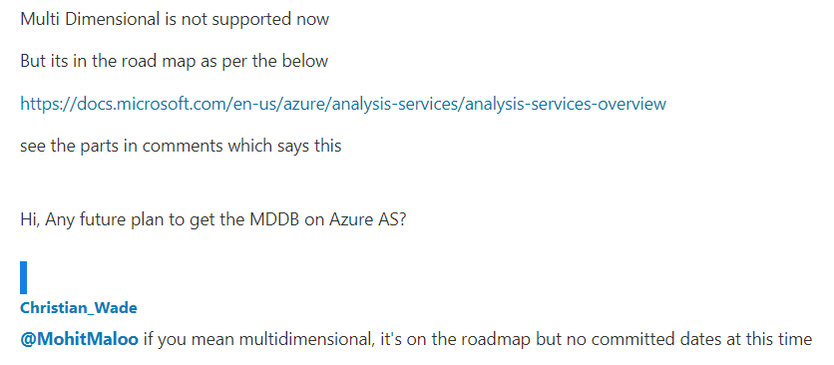
Also…
Also, the Multidimensional SSAS in on the roadmap for Azure SSAS!!
[Source]

Slide 42
Agenda
Introduction
Analyzing the current state
Database design
Cube design
Deployment
Server
Processing
Monitoring
Documentation
Recap
Resources
Q&A
Notes:
Word cloud - https://worditout.com/word-cloud/create

Slide 43

Resources
This presentation (notes and links)
www.pl.seequality.net
www.sqlbits.com/content/
www.jamesserra.com
www.crossjoin.co.uk
Dr. John Tunnicliffe
www.sqlshack.com
archive.codeplex.com/?p=sqlsrvanalysissrvcs
Book: MSSQL 2008 Analysis Services Unleashed
SQLCAT's Guide to BI and Analytics
Whitepapers:
Analysis Services 2008 R2 Performance Guide
SQL Server 2008 R2 Analysis Services Operations Guide
Notes:
Extra: hardware: http://blogs.prodata.ie/post/Selecting-Hardware-for-Analysis-Services-(10GB-1TB-size).aspx

Slide 44
Agenda
Introduction
Analyzing the current state
Database design
Cube design
Deployment
Server
Processing
Monitoring
Documentation
Recap
Resources
Q&A
Notes:
Word cloud - https://worditout.com/word-cloud/create

Slide 45
Q&A
Questions?
Twitter: https://twitter.com/SDrzymala
Mail: slawomirdrzymala@outlook.com

Slide 46
SSAS Multidimensional optimize for large data warehouse
Sławomir Drzymała

Slide 47
SSAS Multidimensional optimize for large data warehouse
Sławomir Drzymała

Slide 48
GOLD SPONSORS
SILVER SPONSORS
BRONZE SPONSOR
STRATEGIC PARTNER

